Slide 1
Care4care
Group 8

Slide 2
Project guidelines

Slide 3
Project guidelines
People need help
People willing to help
They need an application to connect them

Slide 4
our APPlication

Slide 5
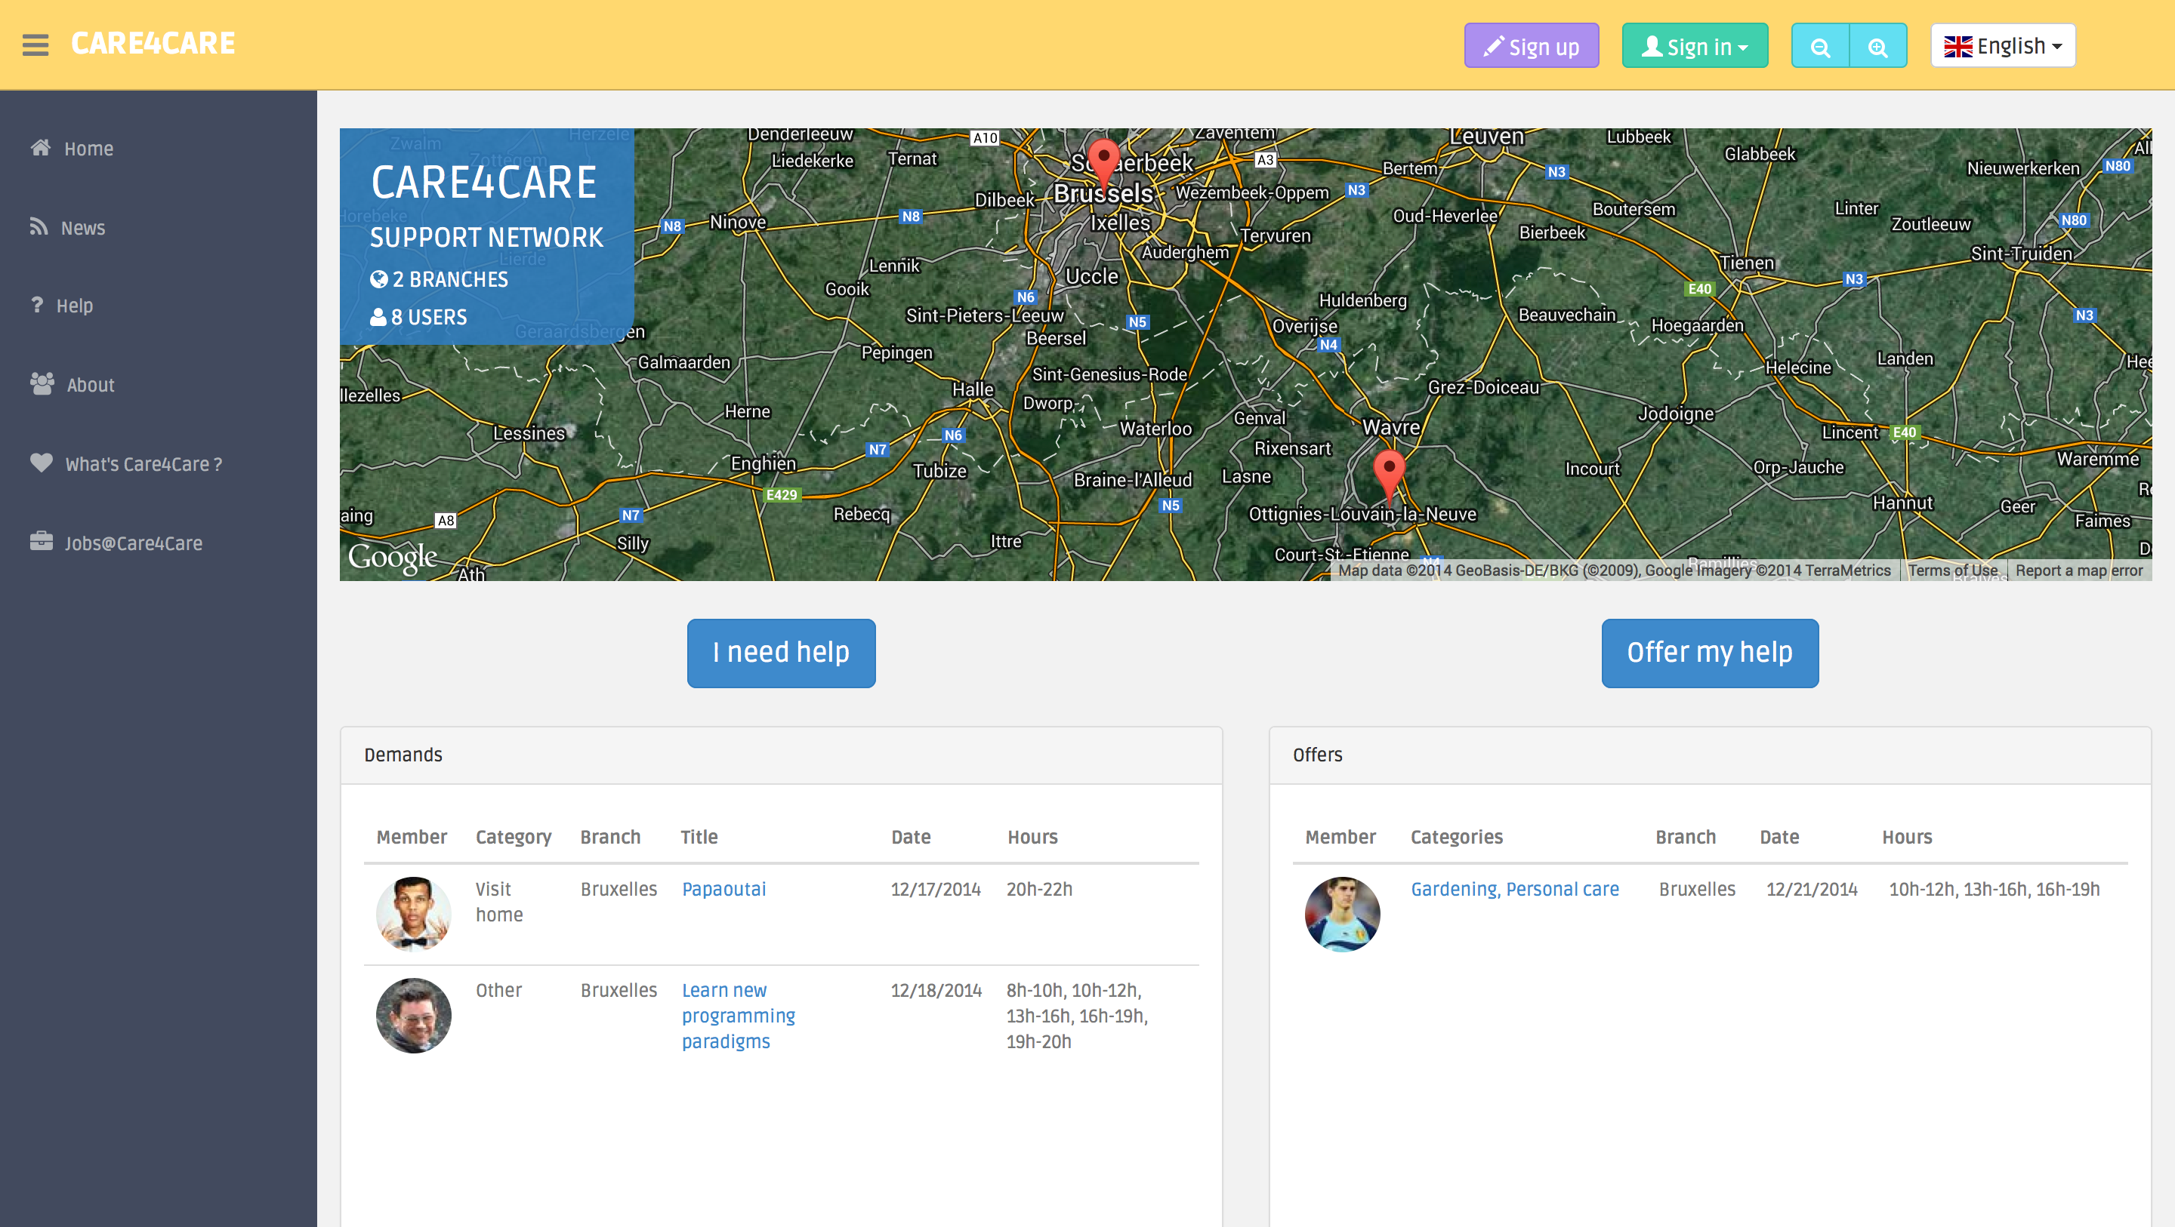
Modern interface

Slide 6
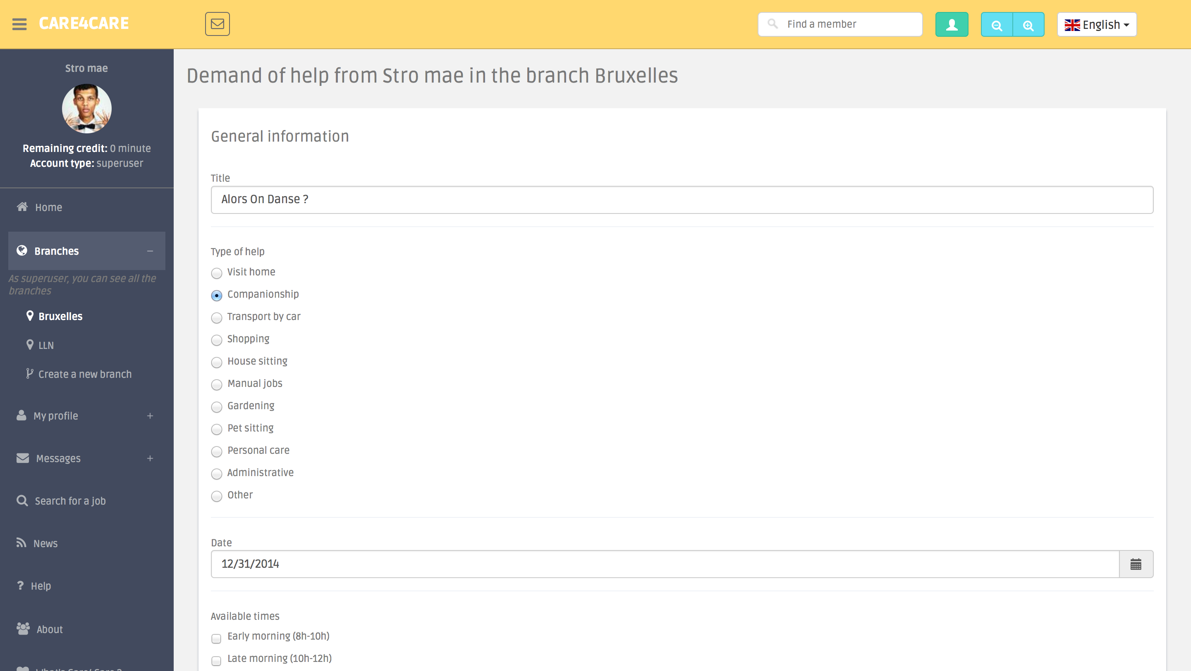
create demand

Slide 7
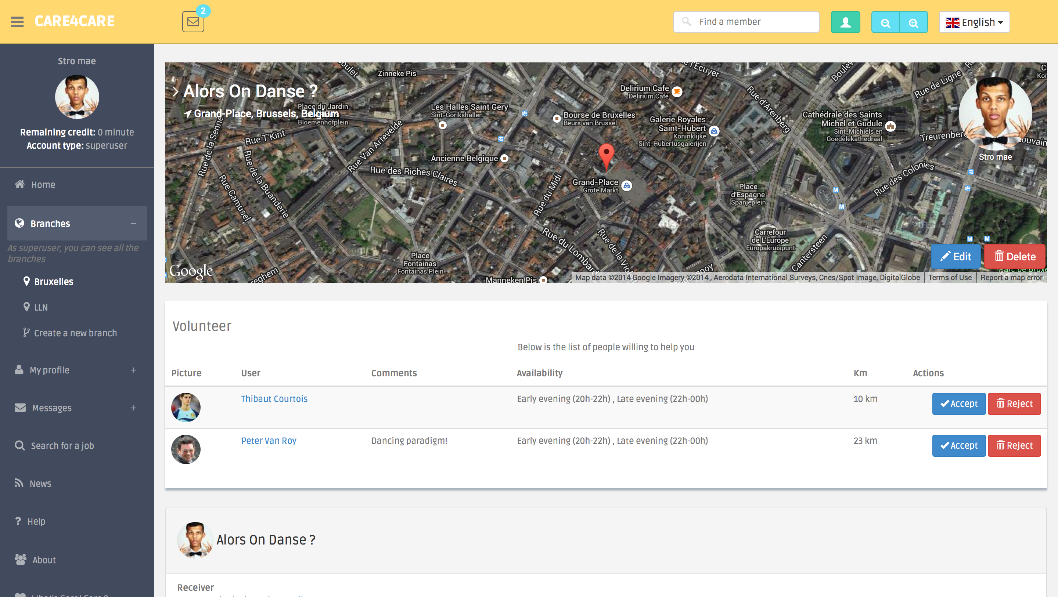
Accept volunteers

Slide 8
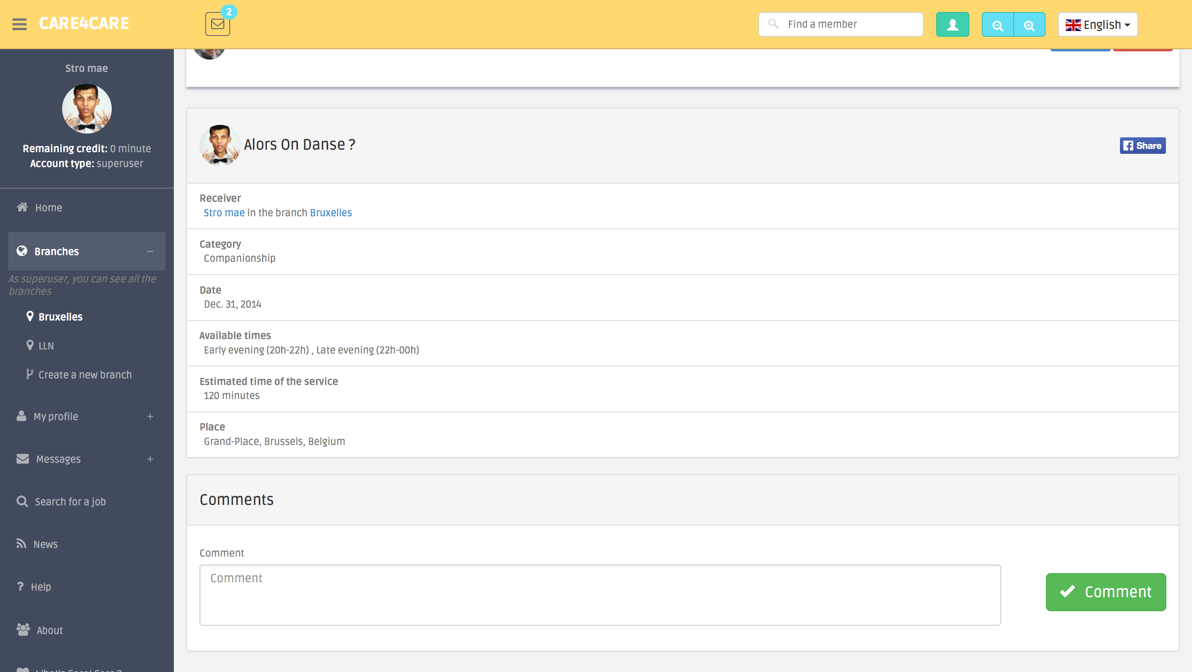
social media

Slide 9
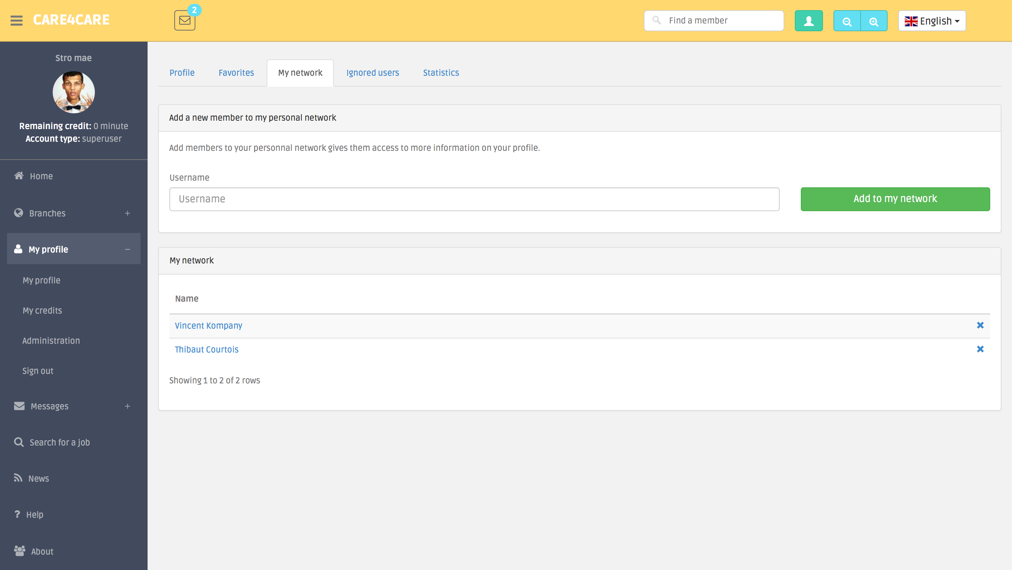
Personal network

Slide 10
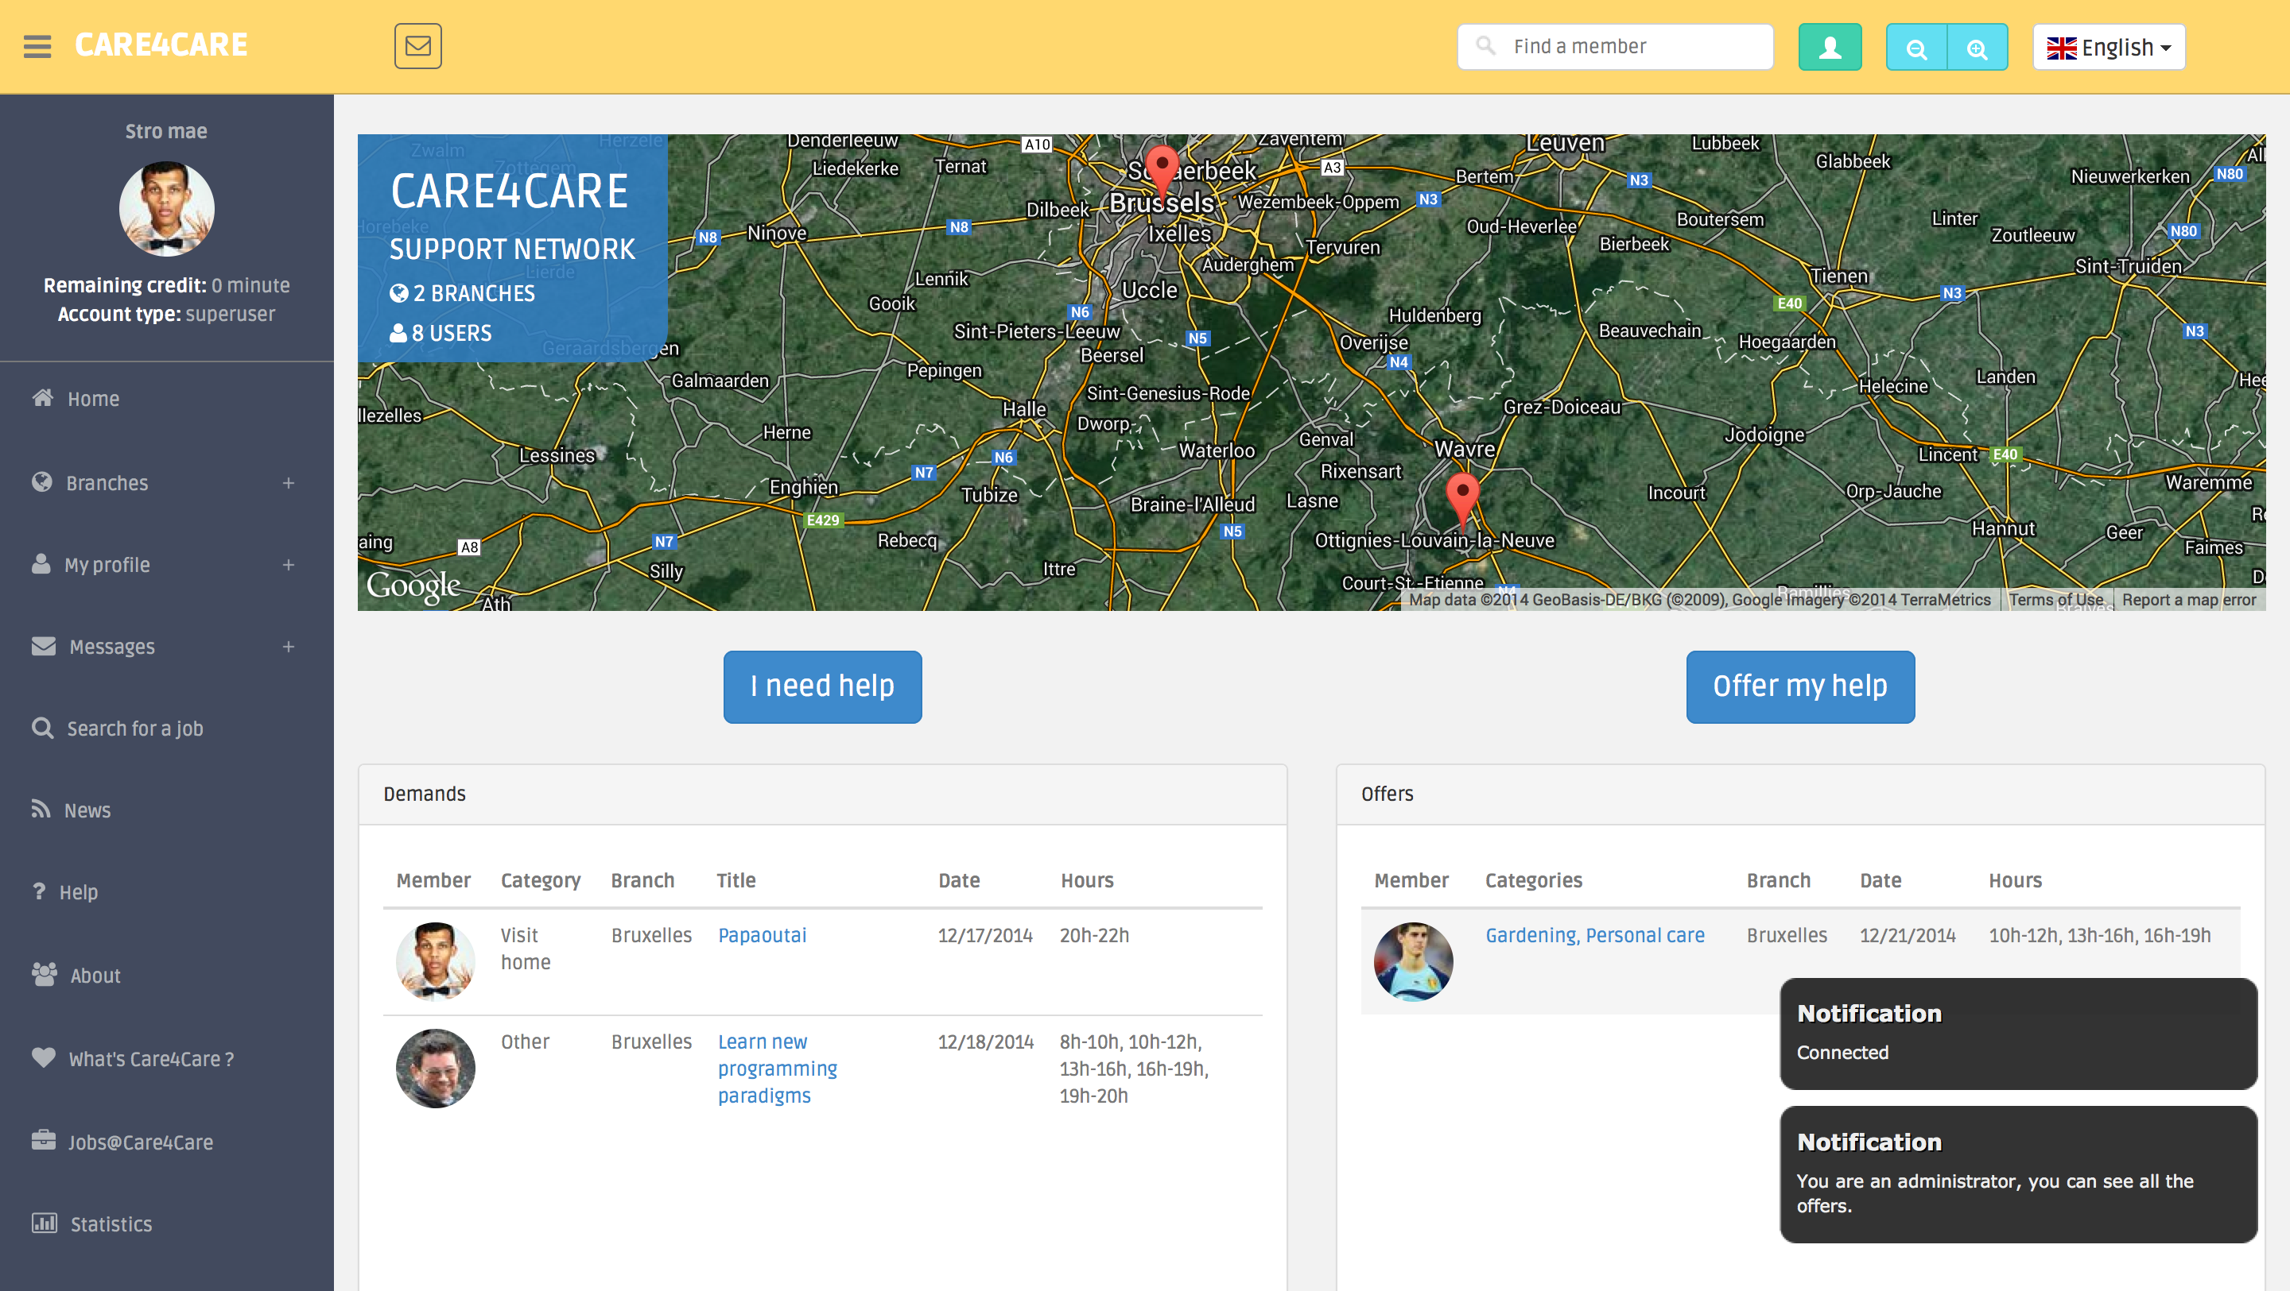
notifications

Slide 11
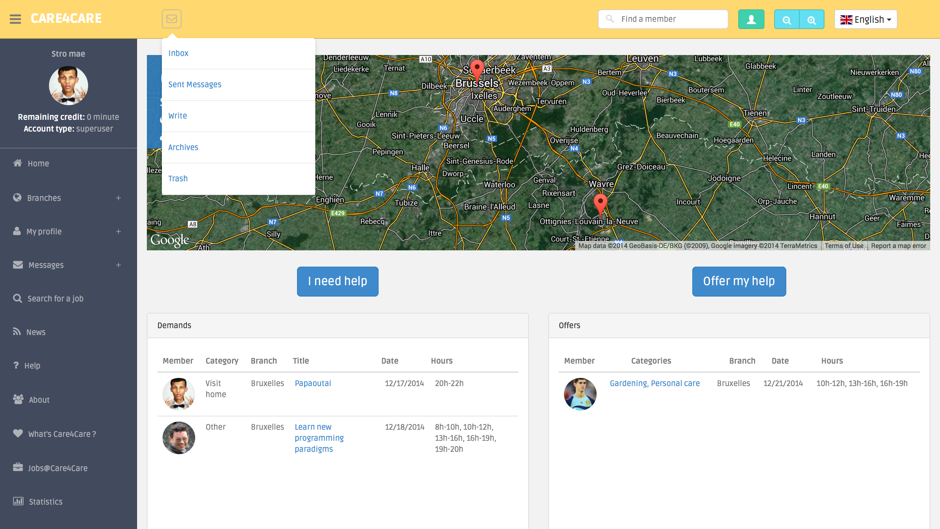
Messages

Slide 12
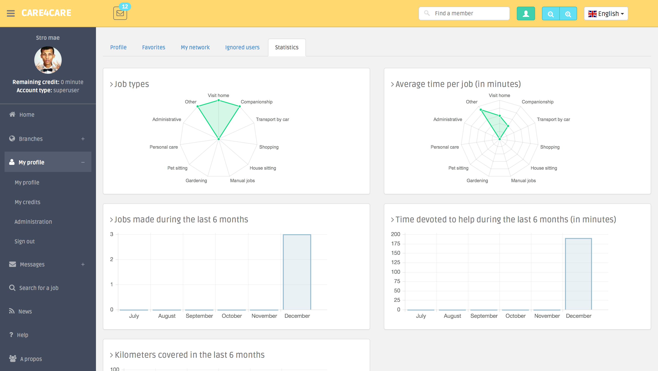
Statistics

Slide 13
DEMO

Slide 14
Development

Slide 15
Development process
4 weeks
4 teams of 2
Coordination with Trello and Github

Slide 16
System requirements & functionalities
Demand and offer matching
Notifications
Statistics
Credit management & gifts
Administration
Social media extension
Privacy
Search
Messages
Profile and branch management

Slide 17
What we didn’t implement
Calendar and events
Recurrent jobs

Slide 18
EXTRAS
Google Maps
Ban from a branch
Zoom

Slide 19
System architecture
Form
Model
View
Template

Slide 20
Particularities of
system implementation
Code maintainability
Use of well-known libraries/packages

Slide 21
Data models
User
Branch
Demand / Offer

Slide 22
Tests
Selenium tests
Unit tests

Slide 23









Technologies

Slide 24
The team
Baptiste Lacasse
(Project Manager)
Thibault Gerondal
(Engineering leader)
Michael Heraly
(Ninja Coder)
Denis Genon
(Analyst Developer)
Victor Velghe
(Marketing & Translation)
Jeremy Vanhee
(Human Resources Manager)
Arnold Moyaux
(Senior Developer)
Alois Paulus
(Conceptual UI Designer)

Slide 25
Thank you

